Slide 1
Control Flow Statements (Part 1)

Slide 2


Today's Learning Objectives
Understand the concept of control flow and its significance in programming.
Identify and differentiate between different types of conditional statements, including if, if-else, and nested if-else.
Comprehend the syntax and functionality of switch-case statements as an alternative to multiple if-else statements.
Apply control flow control statements like break, continue, and return to manage program flow effectively.
Engage in hands-on learning with examples and exercises.

Slide 3
Introduction to Case Flow Statements

Slide 4

Introduction to Control Flow Statements
Consider a scenario where you are deciding whether to go out or stay indoors based on the weather.
How the decision to go out or stay indoors depends on the weather conditions?
Notes:
Imagine you're developing a weather app that provides recommendations for outdoor activities based on the current weather conditions.
Control flow is crucial in this scenario because it determines how the app responds to different weather conditions.
For instance, if the weather is sunny, the app might suggest going for a walk or having a picnic. If it's raining, it might recommend staying indoors and watching a movie.
Without control flow, the app wouldn't be able to differentiate between sunny and rainy weather or provide appropriate recommendations based on the conditions.
By incorporating control flow mechanisms, such as conditional statements and branching statements, you can ensure that the app dynamically adjusts its behavior according to the weather conditions, making it more responsive and user-friendly.

Slide 5

Introduction to Control Flow Statements
Have you ever noticed that when you approach a traffic light, it's either red, green, or yellow? How do you decide when to stop or move?
Notes:
Can anyone share their thoughts on this? Think about your experiences while driving or crossing the street. How do you know when it's safe to go and when you should wait?

Slide 6
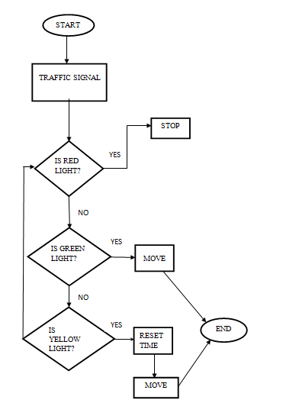
Introduction to Control Flow Statements

Slide 7
Introduction to Control Flow Statements
Control flow directs the flow of execution in a program, determining the sequence in which statements are executed.
It's analogous to giving directions to your program, guiding it through the code and specifying what actions to take and when to take them.

Slide 8
Introduction to Control Flow Statements
Significance in Programming
Control flow is of paramount importance in programming as it enables decision-making and execution of actions based on conditions.
It plays a vital role in creating dynamic and responsive applications, allowing programs to adapt their behavior according to changing circumstances and user input.

Slide 9

Pop Quiz
Which of the following best describes the purpose of control flow statements in programming?
To declare variables and constants
To control the flow of execution in a program
To perform arithmetic operations
To define classes and methods

Slide 10
Pop Quiz
Which of the following best describes the purpose of control flow statements in programming?
To declare variables and constants
To control the flow of execution in a program
To perform arithmetic operations
To define classes and methods

Slide 11
Types of Control Flow Statements

Slide 12
Types of Control Flow Statements
Conditional Statements
Used for decision-making based on conditions.
Before leaving the house, you might use conditional statements to decide what to wear based on the weather.
Looping Statements
Used for executing code repeatedly.
When baking cookies, you often need to repeat certain steps, such as mixing ingredients or rolling dough, multiple times.

Slide 13
Types of Control Flow Statements
Branching Statements
Used for altering the flow of control within a program.
Imagine you're navigating through a maze, and you come across a fork in the path.
You might use a branching statement like a break statement to exit the current path and explore a different route if the current path leads to a dead-end.

Slide 14
Conditional Statements

Slide 15
Conditional Statements
Conditional statements are fundamental tools in programming that enable the program to make decisions based on specific conditions.
They allow different blocks of code to be executed depending on whether certain conditions are met or not, thus controlling the flow of execution in the program.
Conditional statements help in creating dynamic and responsive programs by allowing them to adapt their behavior based on changing conditions or inputs.

Slide 16
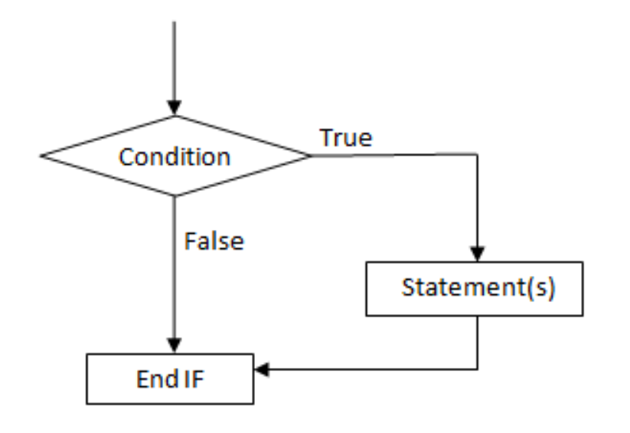
If Statements
The if statement is the most basic form of conditional statement.
It evaluates a condition and executes a block of code if the condition is true.

Slide 17

If Statements

Slide 18
Problem Solving
You're developing a simple login system. If the user enters the correct username and password, they should be granted access; otherwise, they should be denied access.

Slide 19
Problem Solving
Solution file here.

Slide 20
Pop Quiz
Which control flow statement is used to execute a block of code only if a specified condition is true?
if statement
while loop
do-while loop
switch statement

Slide 21
Pop Quiz
Which control flow statement is used to execute a block of code only if a specified condition is true?
if statement
while loop
do-while loop
switch statement

Slide 22
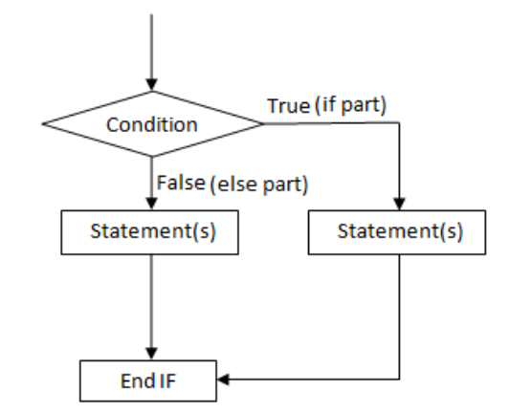
If Else Statements
The if-else statement provides an alternative action if the condition in the if statement evaluates to false.
It executes one block of code if the condition is true and another block of code if the condition is false.

Slide 23
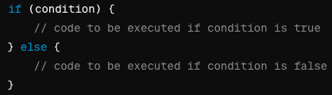
If Else Statements

Slide 24
Problem Solving
You're creating a program to determine if a given number is positive, negative, or zero. Write a Java program using if statements to check and print the appropriate message based on the number's value.

Slide 25
Problem Solving
Solution file here.

Slide 26
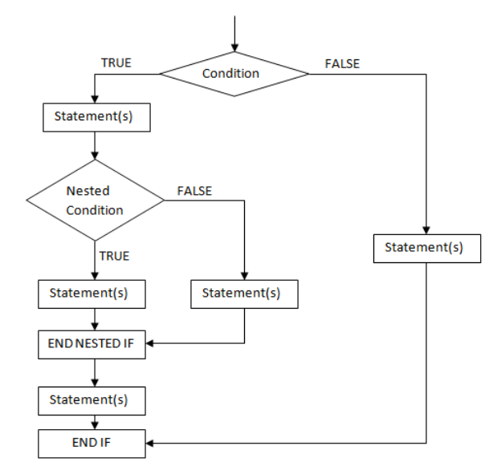
Nested if-else Statements
Nested if-else statements contain another if-else statement inside them, allowing for more complex decision-making.
They are useful when multiple conditions need to be evaluated.

Slide 27
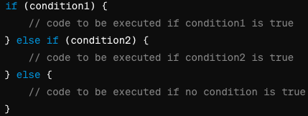
Nested if-else Statements

Slide 28
Problem Solving
You're creating a program to determine the shipping cost for an online order based on the total amount spent. If the total amount is $100 or more, the shipping is free; if it's between $50 and $99, the shipping cost is $5; if it's less than $50, the shipping cost is $10. Write a Java program using nested if-else statements to calculate and print the shipping cost for a given total amount.

Slide 29
Problem Solving
Solution file here.

Slide 30
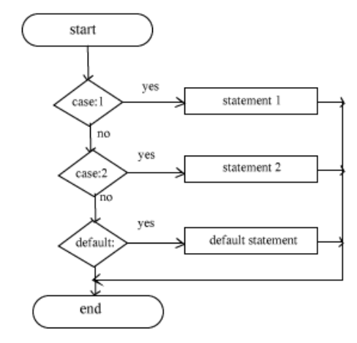
Switch-Case Statements
The switch statement in Java provides an alternative to nested if-else statements for handling multiple conditions efficiently.

Slide 31
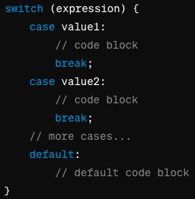
Switch-Case Statements

Slide 32
Problem Solving
You're creating a program to categorize movies based on their genres. Users can input the genre code (1 for Action, 2 for Comedy, 3 for Drama, etc.). Implement a Java program using switch-case statements to assign the corresponding genre name to the given genre code.

Slide 33
Problem Solving
Solution file here.

Slide 34
Pop Quiz
You are developing a virtual pet game where players can choose their pet's behavior based on their preferences. Which control flow statement would you choose to implement the pet's behavior selection process?
If-else statements
Switch-case statements
Nested if-else statements
Loop statements

Slide 35
Pop Quiz
You are developing a virtual pet game where players can choose their pet's behavior based on their preferences. Which control flow statement would you choose to implement the pet's behavior selection process?
If-else statements
Switch-case statements
Nested if-else statements
Loop statements
Notes:
Explanation: Switch-case statements offer a structured approach to handle multiple pet behaviors efficiently, allowing players to select their preferred behavior with ease.

Slide 36
Pop Quiz
You are developing a mobile application that offers different discount coupons to users based on their purchase history and loyalty status. Which control flow statement would you use to efficiently apply the appropriate discount coupon to each user?
If-else statements
Switch-case statements
Nested if-else statements
Loop statements

Slide 37
Pop Quiz
You are developing a mobile application that offers different discount coupons to users based on their purchase history and loyalty status. Which control flow statement would you use to efficiently apply the appropriate discount coupon to each user?
If-else statements
Switch-case statements
Nested if-else statements
Loop statements
Notes:
Explanation: If-else statements offer flexibility in evaluating various conditions and applying different discount coupons based on user-specific criteria.

Slide 38
Problem Solving

Slide 39
Problem Solving
You're developing a program to determine the eligibility of a person for driving based on their age and whether they have a valid driving license. Implement a Java program using if-else statements to check if the person is eligible to drive.

Slide 40
Problem Solving
Solution file here.

Slide 41
Problem Solving
You're creating a program to determine the price of a product based on its category and whether the customer is eligible for a discount. Implement a Java program using nested if-else statements to calculate the final price of the product.

Slide 42
Problem Solving
Solution file here.

Slide 43
Problem Solving
You're developing a program to assign a grade to a student based on their test score. Implement a Java program using switch-case statements to determine the grade based on the score range.

Slide 44
Problem Solving
Solution file here.

Slide 45
Summary
Covered the fundamentals of conditional statements in Java.
Explored how conditional statements enable decision-making in programs based on specific conditions.
Covered the fundamentals of if-else statements, nested if-else statements, and switch-case statements.
Discussed the syntax and usage of if-else statements, nested if-else statements, and switch-case statements for simple and complex decision-making scenarios.
Introduced nested if-else statements for handling multiple conditions within conditional blocks.
Demonstrated the alternative approach of switch-case statements for handling multiple cases efficiently.
Showcased real-world scenarios where conditional statements are commonly used, such as grading systems, eligibility checks, and product pricing.

Slide 46



Slide 47
Thank You
Copyright © Upgrad., All rights reserved
Confidential Information, intended for approved distribution list of Upgrad

